Slide 1
Tensorflow
An Introduction
Content largely based on "Hands on machine learning with scikit-learn and tensorflow"
Gene Olafsen

Slide 2
AI, ML Beginnings
LISP
The OG of AI languages
Symbolics and Lisp Machines – ran LISP natively
Python
Has been the language / platform of choice for machine learning for many years.

Slide 3
theano
Theano an academic project and is the inspiration for TensorFlow.
Theano is a Python library that lets you to define, optimize, and evaluate mathematical expressions, especially ones with multi-dimensional arrays (numpy.ndarray).
Release of Theano 1.0.0. -- November 2017
Theano announced that it has stopped development with the release of 1.0.0

Slide 4
Google Brain
Google Brain is a deep learning artificial intelligence research project at Google.
Combines:
Open-ended machine learning research
System engineering
Google-scale computing resources.

Slide 5
Distbelief
TensorFlow is Google Brain's second-generation machine learning technology.
DistBelief is Google Brain's first machine learning system.
Built using proprietary algorithms implementing deep learning neural networks.
Backpropagation was later introduced, significantly enhancing the neural network performance.

Slide 6
What's in a name?
Tensor – refers to multidimensional data arrays.
Flow – flow refers to a computational graph or the route of tensor operations. TensorFlow executes graph operations utilizing optimized C++ code.
When the tensors are passed around, their values and shapes are updated by the graph operations.

Slide 7
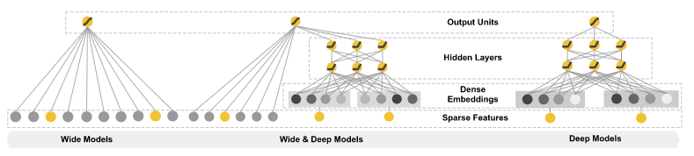
Wide and deep learning
Deep Learning is used when machine learning datasets are large and the target function is complex.
Deep learning automatically select the features and assign the weights.

Slide 8
licensing
Tensorflow is google backed and designed to operate on highly distributed systems.
Version 1.0.0 was released on February 11, 2017
Licensed under the Apache License, Version 2.0

Slide 9
Tensorflow API
Low level API 'TensorFlow Core- provides complete programming control. It is recommend for machine learning researchers and others who require fine levels of control over their models.
The higher level APIs are built on top of TensorFlow Core. These higher level APIs are typically easier to learn and use than TensorFlow Core. In addition, the higher level APIs make repetitive tasks easier and more consistent.
For example: A high-level API like tf.estimator helps manage data sets, estimators, training and inference.

Slide 10
Independent api on top of tensorflow
Keras - a high-level neural networks API, written in Python and capable of running on top of TensorFlow, CNTK, or Theano. It was developed with a focus on enabling fast experimentation.
Pretty Tensor - provides thin wrappers on Tensors so that you can easily build multi-layer neural networks.

Slide 11
Tpu – tensorflow processing unit
Tensorflow Processing Unit (TPU) -- an ASIC built specifically for machine learning and tailored for TensorFlow.
TPU is a programmable AI accelerator
Designed to provide high throughput of low-precision arithmetic
Utilized for running models rather than training them.

Slide 12
Tpu v2
The second-generation TPUs deliver up to 180 teraflops of performance, and when organized into clusters of 64 TPUs, provide up to 11.5 petaflops.

Slide 13
packaging
The downloadable Tensorflow package supports both GPU and non-GPU enabled calculation. Graphic Processor Units, such as those produced by NVidia excel at the matrix operations on which Tensorflow relies.
Note: AMD offers a new line of EPYX-architecture processors which will support TensorFlow. (TensorFlow is not supported on legacy processors.)

Slide 14
Gce – google compute engine
TensorFlow is hosted by GCE
Google Compute Engine (GCE) is the Infrastructure as a Service (IaaS) component of Google Cloud Platform which is built on the global infrastructure that runs Google’s search engine, Gmail, YouTube and other services.
Google Compute Engine enables users to launch virtual machines (VMs) on demand.

Slide 15
Tensorflow at scale
TensorFlow can distribute processing across CPU cores, GPU cores, or even multiple devices like multiple GPUs.
TensorFlow can train a network with millions of parameters on a training set composted of billions of instances with millions of features each.
There is a performance cost associated with the distribution of tensors across multiple processors and/or machines. Tensorflow addresses the performance impact of moving tensor (data) around the system by employing a lossy compression algorithm. 32-bit and 64-bit floating point numbers are reduced to 16-bit resolution.

Slide 16
Tensorflow lite
In May 2017 Google announced a software stack specifically for Android development.
TensorFlow Lite supports a set of core operators, both quantized and float, which have been tuned for mobile platforms.
Enables on-device machine learning inference with low latency and a small binary size.
TensorFlow Lite also supports hardware acceleration with the Android Neural Networks API.

Slide 17
Tensorflow companion libraries
Tensorflow Fold : for dynamic computation graphs
runs the same computation graph across all the inputs in the batch in parallel
Tensorflow Transform for data input pipelines
allows users to define preprocessing pipelines and run these using large scale data processing frameworks
DeepMind’s (Google's) higher-level Sonnet library
Sonnet is a library built on top of TensorFlow for building complex neural networks.
The Tensorflow team also announced a new eager execution mode which works similar to PyTorch’s (Facebook) dynamic computation graphs.

Slide 18
Tensorflow advantage
TF-Learn is the TensorFlow Python API which is compatible with Scikit-Learn
TF-slim API simpifies building, training and evaluating neural networks.
Automatic differentiating (autodiff)

Slide 19
Namespace
The TensorFlow API is vast.
Composed of over 2,500 methods/objects/symbols
The contrib namespace/module contains volatile or experimental code.
Doesn't mean it doesn't work...
Expect change... parameters, hierarchy, etc.

Slide 20
installation
You can install Tensorflow using pip using the following command:
pip install tensorflow
Or if you have a GPU:
pip install tensorflow-gpu
Note that if you're installing the GPU version, you need to have CUDA and cuDNN installed. (next slide)

Slide 21
cuda
CUDA® is a parallel computing platform and programming model developed by NVIDIA for general computing on graphical processing units (GPUs). With CUDA, developers are able to dramatically speed up computing applications by harnessing the power of GPUs.
The NVIDIA CUDA® Deep Neural Network library (cuDNN) is a GPU-accelerated library of primitives for deep neural networks. cuDNN provides highly tuned implementations for standard routines such as forward and backward convolution, pooling, normalization, and activation layers.
Text from NVIDIA website

Slide 22
Device enumeration
# determine the devices available to tensorflow
import tensorflow as tf
from tensorflow.python.client import device_lib
print ([x.name for x in device_lib.list_local_devices()])
['/cpu:0', '/gpu:0']

Slide 23

Tensor

Slide 24
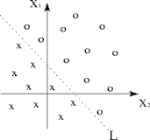
tensor
Tensors are multilinear maps.
A single variable is called a linear map.
Two variables are a bilinear map.
Many variables is called a k-linear map.
A Multilinear map is a function of several variables that is linear separately in each variable.
Linear Separability

Slide 25
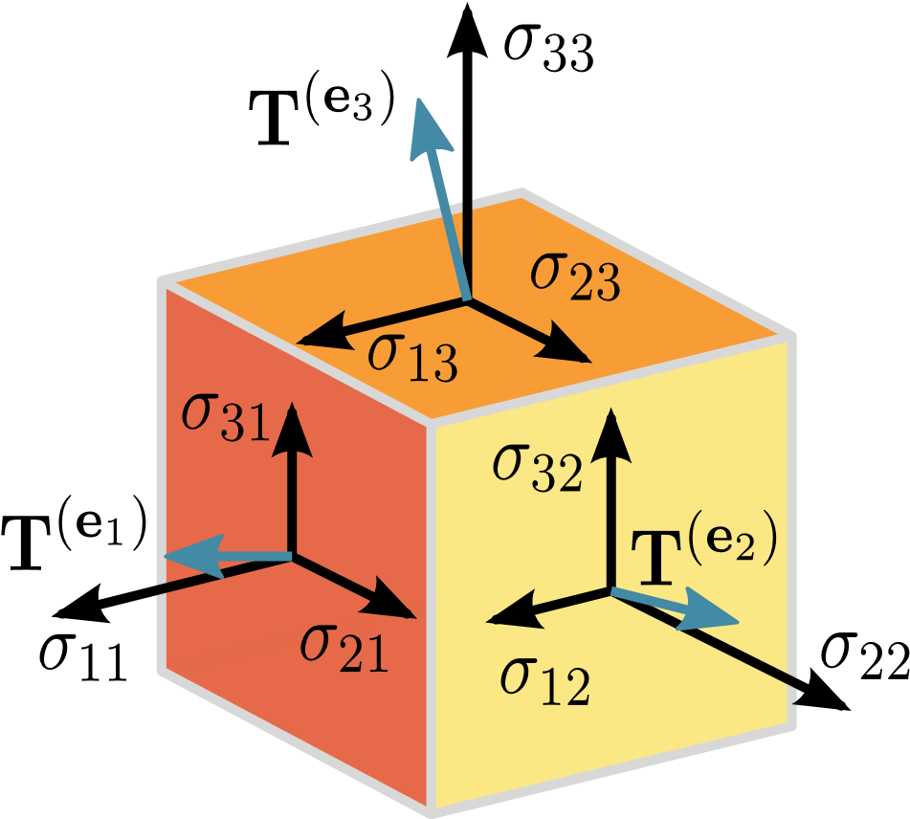
Tensor Visual
Tensor is a N-dimensional vector
https://towardsdatascience.com/a-beginner-introduction-to-tensorflow-part-1-6d139e038278

Slide 26
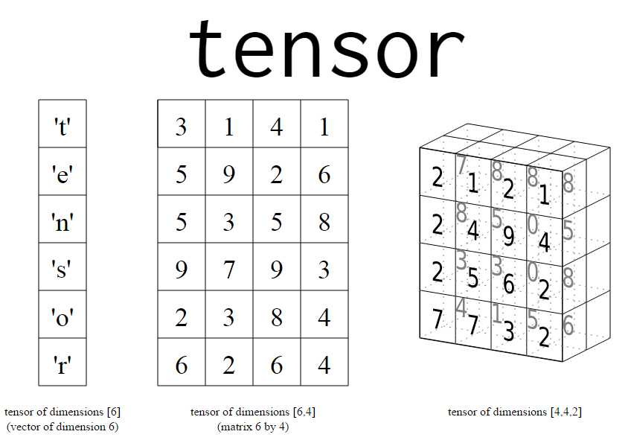
Tensor as an array of matrices
Simplified Tensors
Tensors can be thought of as an array of matrices or n-dimensional matrix.
Scalers – ordinary numbers: 1,2, 3.1415
Vector
Matrix
https://towardsdatascience.com/a-beginner-introduction-to-tensorflow-part-1-6d139e038278

Slide 27
Tensor as code
3 # a rank 0 tensor; a scalar with shape []
[1., 2., 3.] # a rank 1 tensor; a vector with shape [3]
[[1., 2., 3.], [4., 5., 6.]]
# a rank 2 tensor; a matrix with shape [2, 3]
[[[1., 2., 3.]], [[7., 8., 9.]]]
# a rank 3 tensor with shape [2, 1, 3]

Slide 28
Tensors... in tensorflow
In Tensorflow, there are three primary types of tensors:
tf.Variable
tf.constant
Tf.placeholder

Slide 29
Tf.Variable
A TensorFlow variable is the best way to represent shared, persistent state manipulated by your program.
TensorFlow variables are defined and initialized differently from standard Python variables- for the reason that TensorFlow can operate in a distributed environment.
my_variable = tf.get_variable("my_variable", [1, 2, 3])

Slide 30
Tf.constant
# Constant 1-D Tensor populated with value list.
tensor = tf.constant([1, 2, 3, 4, 5, 6, 7])
# Constant 2-D tensor populated with scalar value -1.
tensor = tf.constant(-1.0, shape=[2, 3]) => [[-1. -1. -1.]
[-1. -1. -1.]]

Slide 31
Tf.placeholder
Inserts a placeholder for a tensor that will be always fed.
Note: This tensor will produce an error if evaluated. Its value must be fed using the feed_dict optional argument to Session.run(), Tensor.eval(), or Operation.run()
x = tf.placeholder(tf.float32, shape=(1024, 1024))
y = tf.matmul(x, x)
with tf.Session() as sess:
print(sess.run(y)) # ERROR: will fail because x was not fed.
rand_array = np.random.rand(1024, 1024)
print(sess.run(y, feed_dict={x: rand_array})) # Will succeed.

Slide 32
Flow

Slide 33
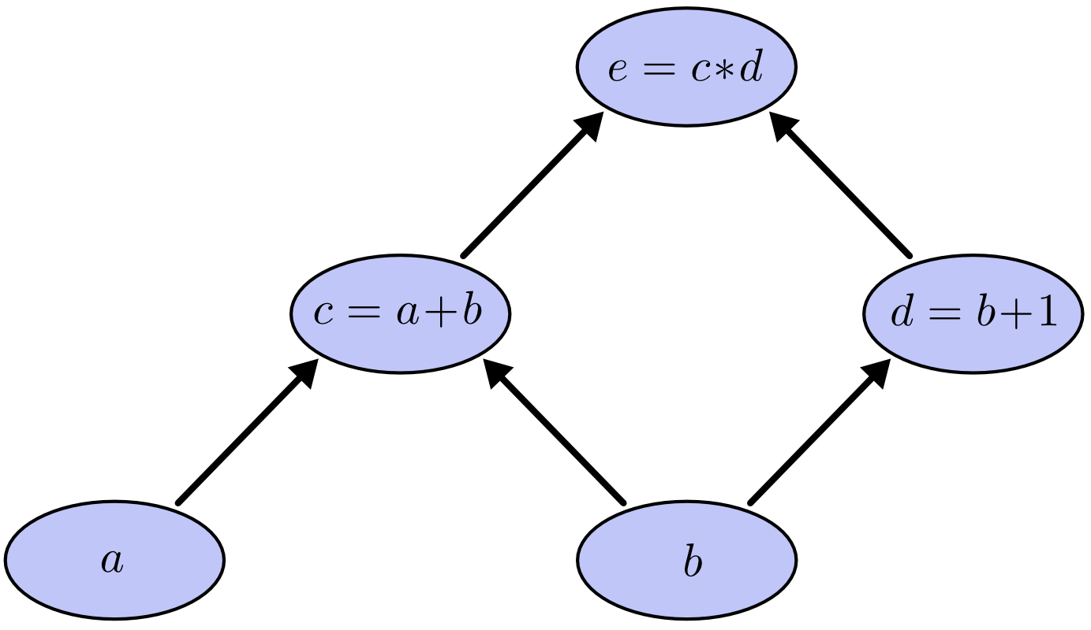
Computational graph
e = (a+b)*(b+1)
Graphic: https://towardsdatascience.com/a-beginner-introduction-to-tensorflow-part-1-6d139e038278

Slide 34
Computational Graphs and Subgraphs
A computational graph always represents a complex operation in hierarchical order.
Leaf vertices are always tensors.
Each operation in the graph should accept a tensor and produce a new tensor.
The operations contained in nodes at the same level are independent of one another- facilitating parallel execution. The operations performed on tensors at lower levels are considered subgraphs.

Slide 35
Define your first graph itf-1
import tensorflow as tf
x1 = tf.constant(7) # define a tensor node (scaler)
x2 = tf.constant(8) # define a tensor node (scaler)
result = tf.multiply.(x1,x2) # define an operation
print(result)

Slide 36
Execute your first graph itf-2
sess = tf.Session() # create a Python session variable
sess.run(result) # execute the graph
sess.close() # close context explicitly

Slide 37
Why "with" itf-3
Ensures that a resource is "cleaned up" when the code that uses it finishes running, even if exceptions are thrown.
with tf.Session() as sess: # open session context
output = sess.run(result) # execute graph
print(output) # display result

Slide 38
Variable initialization ITF-4
It is important to understand that the code does not perform any calculations until the graph is executed.
Constants are initialized before the graph is executed (as we saw in previous examples)
Variables are not initialized before the graph is executed.
Variables can be individually initialized or all variables for a session can be initialized at once.

Slide 39
Managing Graphs ITF-MG1
Nodes are automatically added to the default graph.
NOTE: tf.reset_default_graph() can be used to reset the default graph without having to restart the Jupyter kernel.
my_var = tf.Variable(4)

Slide 40
Node value lifecycle
W
TensorFlow evaluates dependent nodes in a graph first.
w = tf.constant(3)
x = w + 2
y = x + 5
z = x * 3
X
NOTE: All node values are dropped between graph runs EXCEPT variable values which are maintained by the session.
Y
Z

Slide 41
Sessions and variables
Single-process TensorFlow: variables are associated with sessions. Multiple sessions will each have their own copy of each variable.
Distributed TensorFlow: variables are stored on servers. Thus, multiple sessions may share variables. (this is covered in detail in chapter 12)

Slide 42
Linear Regression with tensorflow
Linear regression was performed using Scikit-learn in chapter 4.
The advantage of using TensorFlow (over NumPy and Scikit-learn) in calculating theta- which minimizes the cost function- is the GPU will be used if available.
See ITF-RG1- ITF-RG3

Slide 43
Batch Gradient Descent
The basic idea of Gradient Descent is to iteratively tweak parameters to minimize the cost function.
The following examples will:
Manually compute the gradients
Use TensorFlow's autodiff feature to compute the gradients automatically
Demonstrate TensorFlow's out-of-the-box optimizers

Slide 44
Normalize your input features!
It is important to first normalize the input features vectors, or else training may be much slower.
TensorFlow, NumPy or Scikit-learn all offer a StandardScaler.

Slide 45
GradientS
Manual Gradient Calculation: ITF-GD1
TensorFlow's autodiff feature automatically and efficiently computes gradients for you.
The gradients() function accepts two parameters: an operation and a list of variables.
The gradients() function creates a list of operations (one per variable).
ITF-GD2

Slide 46
Using an Optimizer
TensorFlow API replaces 'hand coding'
mse = tf.reduce_mean(tf.square(error), name="mse")
gradients = 2/m * tf.matmul(tf.transpose(X), error)
training_op = tf.assign(theta, theta - learning_rate * gradients)
mse = tf.reduce_mean(tf.square(error), name="mse")
gradients = tf.gradients(mse, [theta])[0]
training_op = tf.assign(theta, theta - learning_rate * gradients)
mse = tf.reduce_mean(tf.square(error), name="mse")
optimizer = tf.train.GradientDescentOptimizer(learning_rate=learning_rate)
training_op = optimizer.minimize(mse)

Slide 47
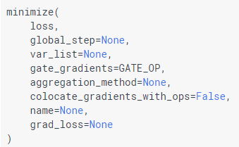
Tensorflow optimizer
One Line:
training_op = tf.train.GradientDescentOptimizer(learning_rate=learning_rate).minimize(mse)

Slide 48
Available Optimizers
AdadeltaOptimizer
AdagradDAOptimizer
AdagradOptimizer
AdamOptimizer
GradientDescentOptimizer
MomentumOptimizer
ProximalAdagradOptimizer
ProximalGradientDescentOptimizer
RMSPropOptimizer
SyncReplicasOptimizer

Slide 49
Feeding data to the training algorithm
The code will be modified to implement Mini-batch Gradient Descent.
Mini-batch computes the gradients on small random sets of instances of training data called mini-batches.
Advantages:
Performance boost from hardware optimization of matrix operations.
Algorithm's progress in parameter space is less erratic than SGD.
Walks closer to the minimum than SGD, but may be harder to escape from local minima.

Slide 50
Code modification ITF-MBGD1-3
Create TensorFlow Placeholder nodes which will contain the feature/label mini batch values.

